Slide 1
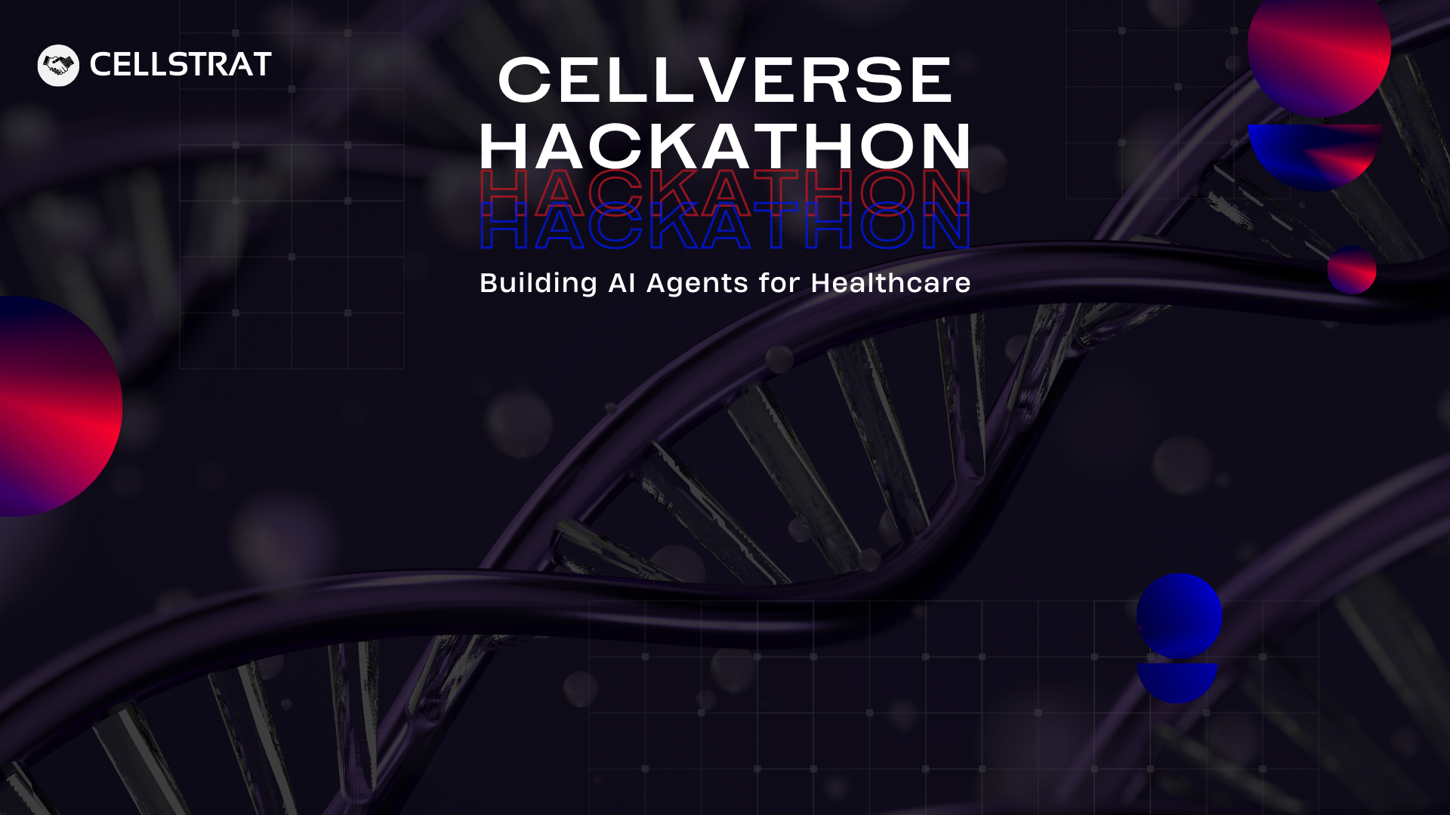
GrandHealth AI
Team Details
Team Member 1 (Leader):
Ravindran
Organisation Name:
DevopZ Consultants.
Team Member 2:
Type name here
Email Id (Team Leader):
ravi@devopzconsultants.com
Team Member 3:
Type name here
Contact Number (Team Leader):
90033 69718
Team Member 4:
Type name here

Slide 2

Problem Statement
1.
Briefly describe the healthcare problem you are addressing.
The shift from joint families to nuclear households has created a knowledge gap in traditional healthcare wisdom. Despite advanced technology and medical facilities, we're missing the personalized, holistic guidance that grandparents once provided in our families—practical advice for everyday wellness that balanced traditional knowledge with care and empathy.
This generational disconnect has led to over-reliance on fragmented healthcare systems and impersonal digital solutions that often fail to address preventive care in a culturally relevant context.
2.
What is your proposed AI solution?
Our solution is an AI-powered wellness companion that bridges traditional healthcare wisdom with modern medical knowledge. This digital advisor provides personalized guidance inspired by the holistic, preventive approach that was traditionally offered by family elders.
The platform creates continuity through relationship-building and adaptation to individual needs, focusing on wellness rather than just disease management. By combining the best of traditional wisdom with evidence-based approaches, our solution offers accessible preventive healthcare that respects cultural context while recognizing when professional medical care is necessary.
3.
Why is this solution impactful?
Our solution addresses a critical gap in modern healthcare through:
Preventive Focus, Cultural Relevance, Accessibility, Holistic Care, Empowerment

Slide 3
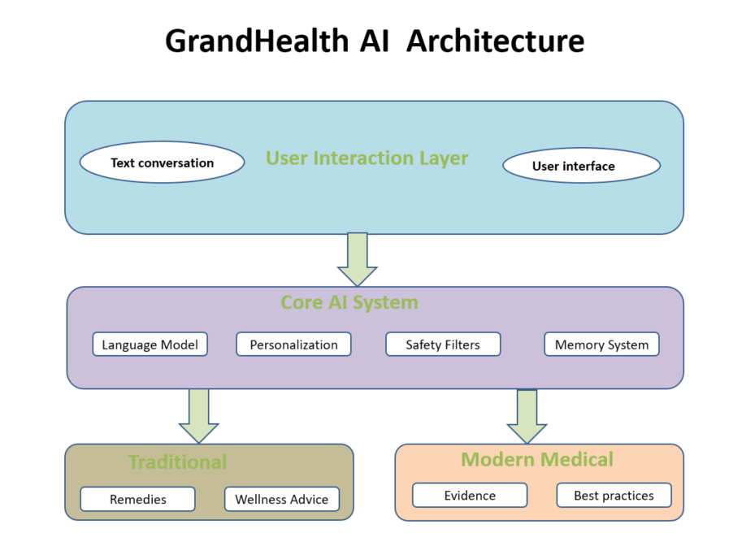
Solution Architecture & Tech Stack
Key technologies, frameworks, or APIs you plan to use.
Example: OpenAI LLM’s , Memory Systems, LlamaIndex, Fast API, Airflow, postgress/redis, social chat

Slide 4
Project Implementation Plan
Note: Provide a step-by-step breakdown of tasks and modules you will be implementing over the course of the hackathon (over the 2.5-day build phase i.e. from Thursday to Saturday). Mention the core functionalities to be developed.
Day 1 | Day 2 | Day 3
Core system architecture setup | Safety protocols and ethical guidelines | Deployment planning
Initial personalization system | Knowledge expansion | Response quality
Cultural adapt systems | User experience refinement | User testing with diverse demographics

